Slide 1
RECOMMENDATION SYSTEMS CS –691RS SPRING 2017 Personalized Book Recommender System for Amazon Books Dataset
ARUNIMA CHAUDHARY
ARATRIKA SARKAR

Slide 2
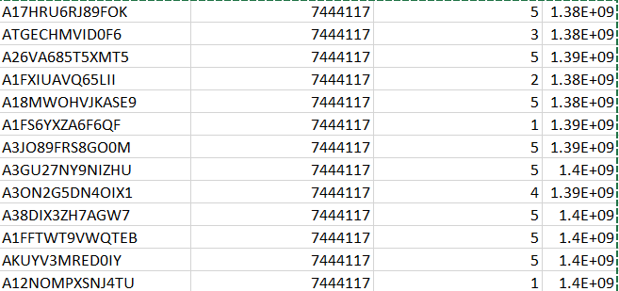
DATASET SELECTION
The dataset is the Books dataset from the Amazon Product Data by Julian McAuley, UCSD
The dataset Consists of user_id, item_id, ratings, timestamp
The data was initially sorted by item_id
Total number users: 8026324
Total number of items: 2330066
Considered number of datapoints:10000

Slide 3
DATA PRE PROCESSING TRAIN – TEST SPLIT
For every user, the items rated by each user was sorted and then one item from the rated items was inserted into the test set and the rest were inserted into the training set.
This approach was taken because of the sparsity of data in the dataset.

Slide 4
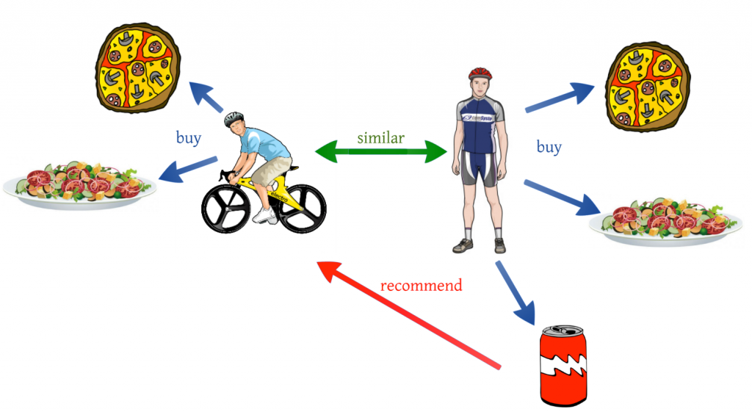
RATING PREDICTION
Prediction algorithm used : User Based Collaborative filtering.
Look for users who share the same rating patterns with the active user (the user whom the prediction is for).
Use the ratings from those like-minded users to calculate a prediction for the active user.
We have implemented the algorithm from scratch

Slide 5

EVALUATING PREDICTION
The predictions are evaluated by calculating MAE and RMSE using Jaccard similarity
Mean Absolute Error (MAE): MAE measures the average magnitude of the errors in a set of predictions, without considering their direction.
Mae obtained : 1.5693

Slide 6

EVALUATING PREDICTION
The predictions are evaluated by calculating MAE and RMSE.
Root mean squared error (RMSE): RMSE is a quadratic scoring rule that also measures the average magnitude of the error. It’s the square root of the average of squared differences between prediction and actual observation.
RMSE obtained : 2.0174

Slide 7
JACCARD vs COSINE SIMILARITY
In Cosine similarity, the number of common attributes is divided by the total number of possible attributes. Whereas in Jaccard Similarity, the number of common attributes is divided by the number of attributes that exists in at least one of the two objects.
The Cosine index could be used to identify plagiarism, but will not be a good index to identify mirror sites on the internet. Whereas the Jaccard index, will be a good index to identify mirror sites, but not so great at catching copy pasta plagiarism (within a larger document).
We have evaluated MAE and RMSE on both the indices(Cosine and Jaccard) and found Jaccard to be the better one.

Slide 8
ITEM RECOMMENDATION
A ranking list of recommended items a recommendation list for each user is created.
The length of recommendation list is 10.
The recommended items are items that the user didn’t purchase before. The algorithm recommends the items from the test set.
The ratings are predicted on all the items that user didn’t buy before, then sorting the items in descending order of the predicted rating and finally take the top 10 items as the recommendation list.

Slide 9
EVALUATION - PRECISION
Precision: percentage of testing items in the 10 recommended items, calculate the precision for each user first, then average the numbers from all users
Precision obtained : 0.89%
The precision obtained is low because of sparsity in test dataset.

Slide 10
EVALUATION -RECALL
Recall: percentage of recommended testing items in all the testing items for a user, also average the recall of all users to get the final recall.
Recall obtained : 8.06%

Slide 11
EVALUATION F - MEASURE
F-measure: F=2*Precision*Recall / (Precision + Recall)
F-measure obtained : 1.8029

Slide 12
EVALUATION EXECUTION TIME
The execution time taken for 10000 data points is 22.5 hours.

Slide 13
CONCLUSION
EVALUATION MESURES | VALUES
PRECISION | 0.89%
RECALL | 8.06%
F MEASURE | 1.8029
MAE | 1.5693
RMSE | 2.0174
EXECUTION TIME | 22.5 hours

Slide 14
THANK YOU

